Slide 1


Traumatic crises as revaluation opportunities for stigmatized varieties: Maintaining strength and a sense of community with Emilian and Viennese
Jessica Iubini-Hampton (University of Liverpool)
Jessica.Iubini-Hampton@liverpool.ac.uk
Barbara Soukup (University of Vienna)
barbara.soukup@univie.ac.at

Slide 2
The Argument:
Stigmatised varieties can gain currency in times of crisis – but how?
Our approach:
Repurposing the ethnographic framework of nexus analysis as a heuristic for discovery of how this works:
"Broader social issues are ultimately grounded in the micro-actions of social interaction" (Scollon & Scollon 2004: 8)
Pick out a moment of social action that embodies the issue under study
Identify and analyse the discourses cycling through this moment (i.e. intersecting and co-creating the moment of social action)
This way, unravel the phenomenon

Slide 3
The Argument:
Stigmatised varieties can gain currency in times of crisis – but how?
A moment of social action that embodies the issue under study:
>>Doing community through the use of a stigmatized local variety<<
Identify and analyse the salient discourses cycling through and constructing this moment of social action

Slide 4
Emilian and Viennese in times of crisis – two case studies

Slide 5
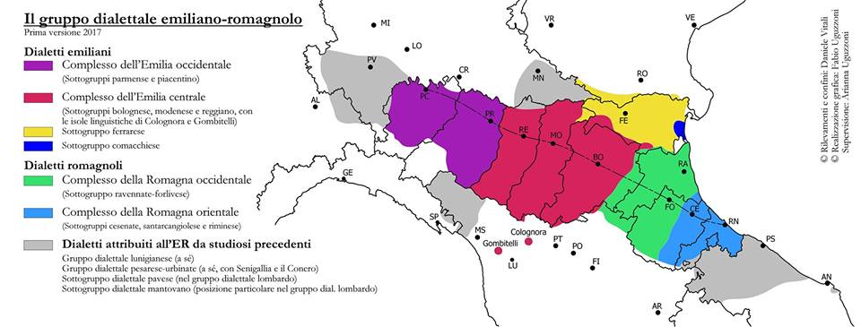
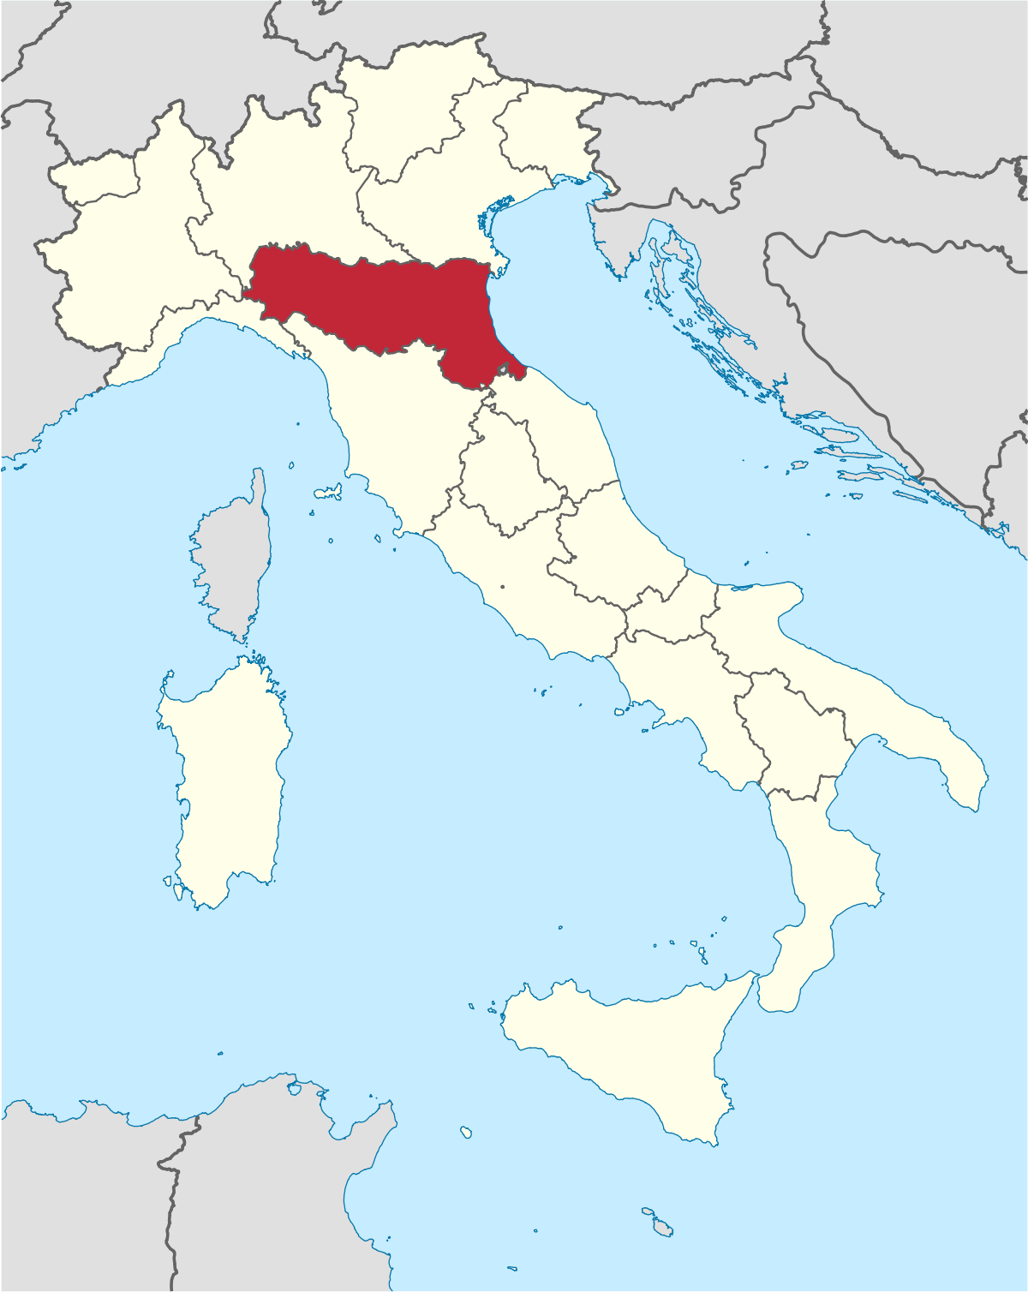
Where is Emilian spoken?
(Vitali, Uguzzoni, Uguzzoni 2017)

Slide 6
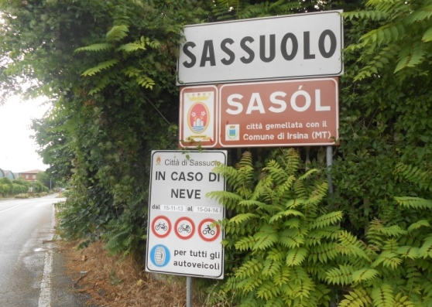
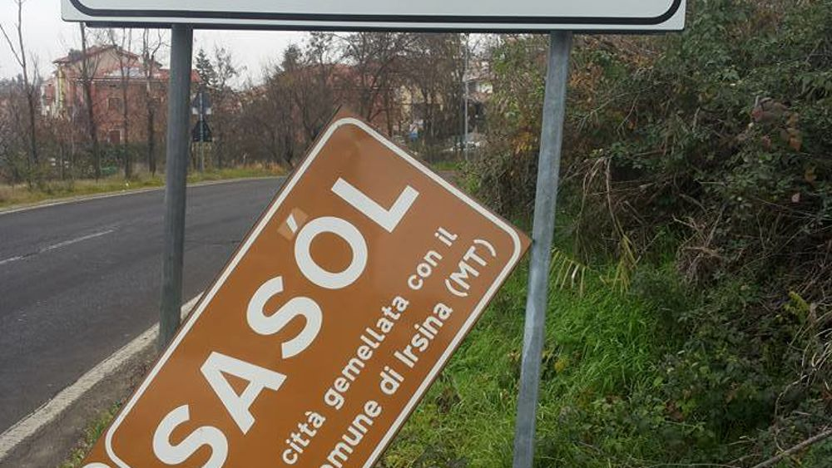
Status and Vitality
Emilian has no official status in Italy
Bilingual road signage
Shifting towards Italian
Language use: adults and older. Only taught to children in some rural areas
Emilian is less and less publicly used
More research is needed
(Modena Today 2015)

Slide 7
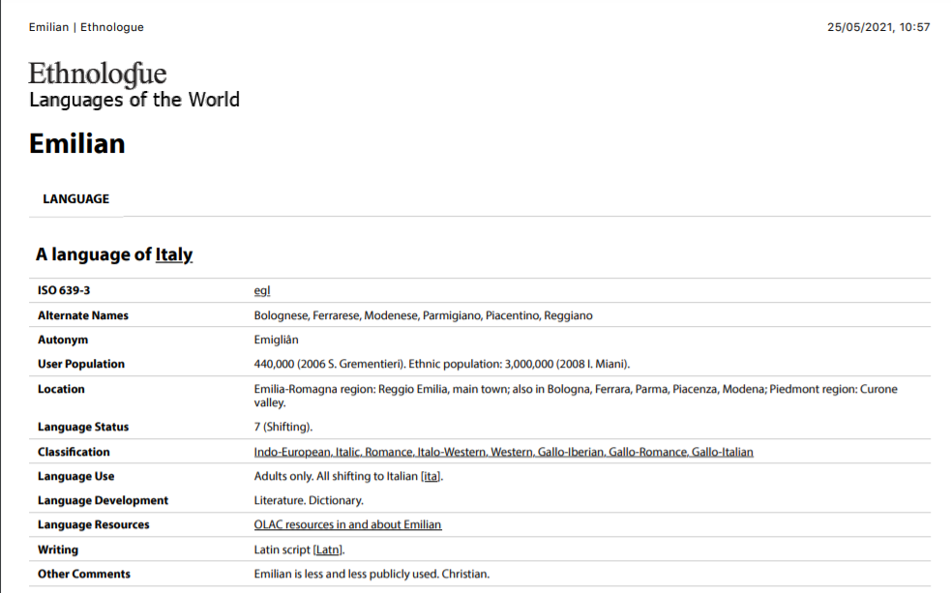

Slide 8
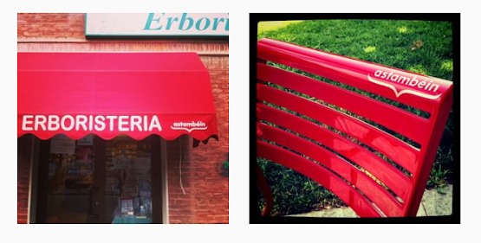
Doing community through Emilian

Slide 9

Doing community through Emilian – Salient discourses cycling through the moment of social action:
Local language: Emilian (ancestral)
External factors: earthquake, death, uncertainty, livelihoods
General spirit: fear, hope, recovery
Local collectives: “a stam béin” (meso level), local institutions, charity practices
Local habitus: abandonment from the State, fencing for oneself
Language attitudes: family, domestic domain, no-frills
Local culture: local businesses, history of the region

Slide 10
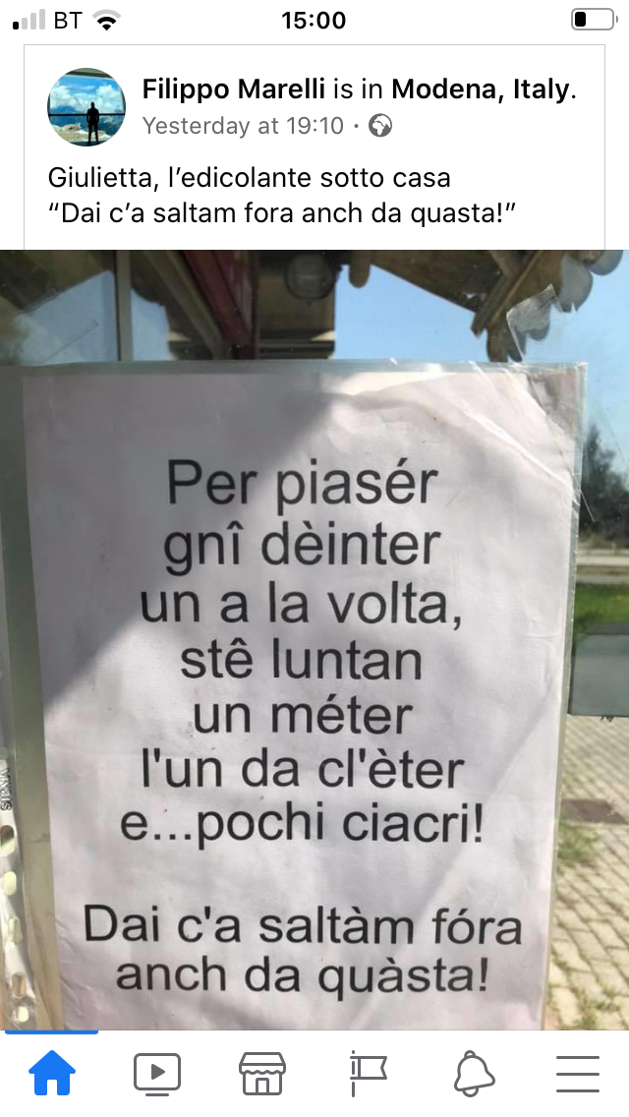
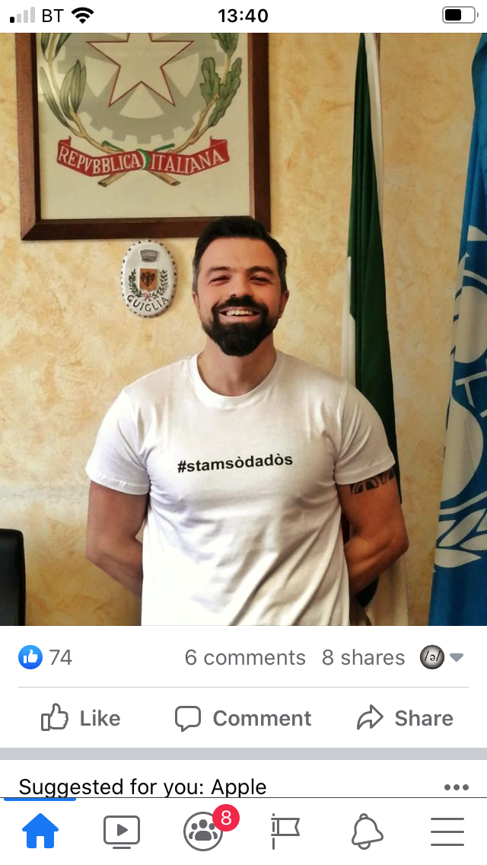
Doing community through Emilian (II)

Slide 11

Doing community through Emilian – Salient discourses cycling through the moment of social action:
Local language: Emilian (ancestral)
External factors: pandemic, death, uncertainty, livelihoods
General spirit: fear, hope, recovery
Local collectives: “stam sò da dòs” (grass-root), local institutions (endorsing), charity practices
Local habitus: abandonment from the State, fencing for oneself
Language attitudes: family, domestic domain, no-frills
Local culture: local businesses, history of the region

Slide 12
The second case study: Viennese

Slide 13
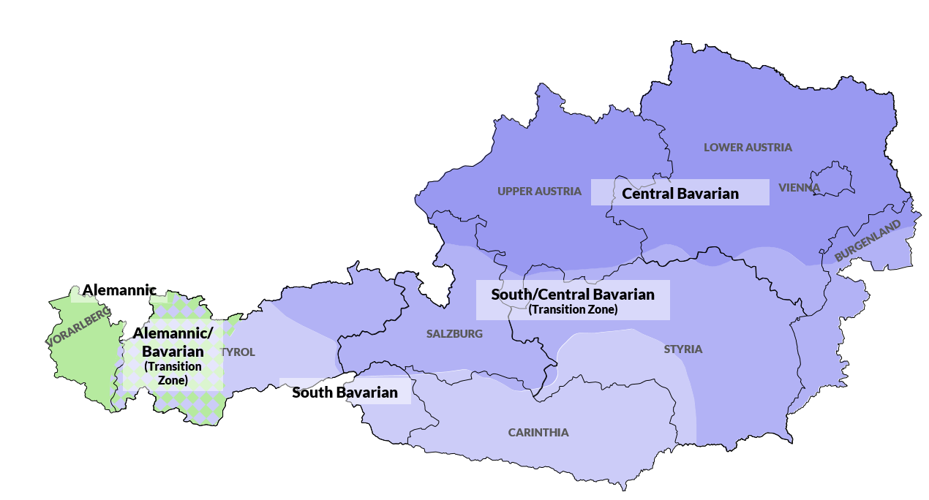
Background
Viennese: an eastern Central Bavarian-Austrian dialect of German
Enregisterment based on its locality and history (capital city), some lexical features (borrowings, swear words) and language attitudes:
Consensually, the least-liked dialect of Austria, by Austrians; working class (Moosmüller 1991, Steinegger 1998)
Central Bavarian-Austrian in general: +coarse, +emotional, +aggressive, +humorous (cf. Soukup in press)
CC-BY-SA M. Seltmann dioe.at | regionalsprache.de
Considerable dialect loss in urban areas, particularly in Vienna (Lenz 2019)
The language of public space and official interaction is standard (no official status for dialect/ Viennese)

Slide 14
The public crisis
On November 2nd, 2020, a lone terrorist with a machine gun opened fire in a highly frequented outdoor café area of downtown Vienna, killing four people and injuring many more, before being shot and killed by police.
Immediately afterwards, a story broke about a video supposedly showing the following: after the terrorist had moved to another location and fired more shots, there is a short silence and then someone shouts at the terrorist from a balcony: "Schleich di, du Oaschloch!" ("Get lost, you asshole!").
The story of the yell went viral, getting picked up on social media, in the national and international press, TV news, comedy shows…
T Shirts (and other accessories) were printed with the slogan and mostly sold for charity

Slide 15
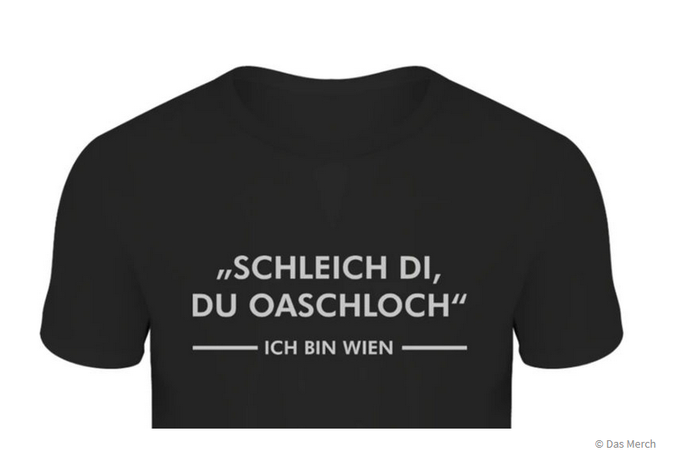

Slide 16
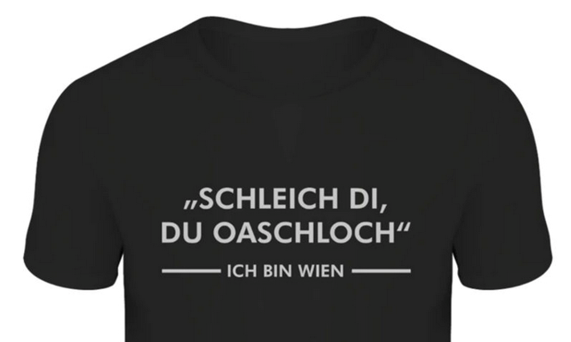
Doing community through Viennese – Salient discourses cycling through the moment of social action:
Local language: Viennese/Central Bavarian-Austrian dialect
External factors: terrorism, death, uncertainty
Collective spirit: fear, defiance, grit
Local collectives: The public, (social) media, T Shirt producers (charities)
Local habitus: 'Wiener Schmäh', unfriendliness
Language attitudes: coarse, emotional, aggressive, disliked; humorous
Local culture: City of Vienna, TV series "Ein echter Wiener geht nicht unter"

Slide 17
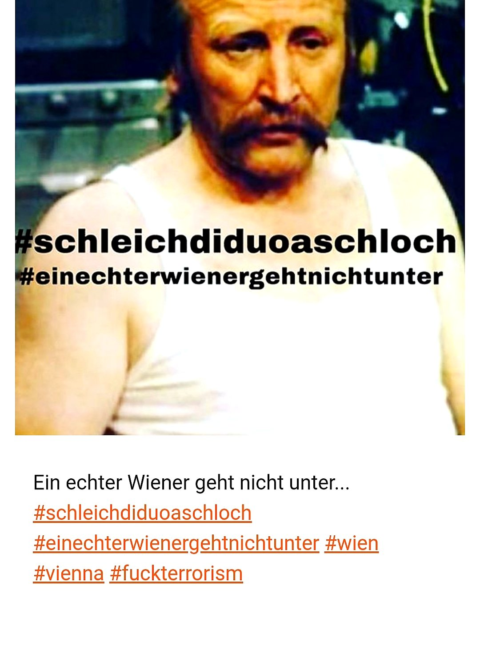
"Ein echter Wiener geht nicht unter" (A real Viennese never goes down)
Austrian cult television series (1975-1979)
The main character Edmund 'Mundl' Sackbauer is a working class anti-hero – tyrannical, irascible, beer-drinking, unpolished, user of coarse language

Slide 18
Doing community through Viennese
"And because the yell exhibits so much courage and at the same time is 'typically Viennese', it garners much attention in social media. Many Austrians, particularly Viennese, shared it as a sign of their resistance. [...]
On the social media platform, users are thanking the 'balcony yeller' for his courage, and themselves draw strength from it and share his line as a show of solidarity."
Salzburger Nachrichten, November 3, 2020;
https://www.sn.at/panorama/oesterreich/schleich-didu-oaschloch-so-trotzt-wien-dem-terrorismus-95121493

Slide 19
The Argument:
Stigmatised varieties can gain currency in times of crisis – but how?
We picked out the moment of social action Doing community through the use of a stigmatized local variety
and identified and analysed the sociocultural discourses cycling through it.
What did we learn?

Slide 20
Conclusion(s)
Emilian/Viennese is the preferred language choice in crisis and rallying cries because it is ancestral, local and "safe"; a vector for emotional language which is needed for social healing (Hutchison & Bleiker 2008)
Defiance of external forces (standard language, crisis), grit
Elusive concept of 'covert prestige' (Trudgill 1972): private, family, emotion, gritty language
Doing community is an underexplored yet clearly salient context for stigmatized and even endangered varieties to regain currency and reclaim space in local repertoires and collective minds.

Slide 21
This is not limited to Emilian and Viennese…
Similar instances:
“This catastrophic natural event [the deadly 1976 earthquake in Udine] strengthened the Friulian regional identity with a subsequent partial revitalization of the minority language. This event slowed down the decay of Friulian, delaying its death of about a decade (Picco p.c.).” (De Cia 2013: 43)
Anecdotal experience with Scots: “I have been using more often on social media during the pandemic because it is intimate and makes me feel I’m with somebody”

Slide 22
References
De Cia, S. (2013). La vitalitât dal furlan te provincie di Udin: un studi sociolinguistic. Udine: Provincia di Udine.
Hutchison, E., & Bleiker, R. (2008). Emotional reconciliation: Reconstituting identity and community after trauma. European Journal of Social Theory, 11(3), 385-403.
Lenz, A.N. (2019). Bairisch und Alemannisch in Österreich. In: J. Herrgen & J.E. Schmidt (Eds.), Deutsch. Language and Space Band 4 (318–363). De Gruyter.
Moosmüller, S. (1991). Hochsprache und Dialekt in Österreich: Soziophonologische Untersuchungen zu ihrer Abgrenzung in Wien, Graz, Salzburg und Innsbruck. Böhlau.
Scollon, S. W. & Scollon, R. (2004). Nexus analysis: Discourse and the emerging internet. Routledge.
Soukup, B. (forthc.). Über die empirische Spracheinstellungsforschung in Österreich. In M. Pucher (Ed.), Akustische Phonetik und ihre multidisziplinären Aspekte: Ein Gedenkband für Sylvia Moosmüller. Verlag der Österreichischen Akademie der Wissenschaften.
Steinegger, G. 1998. Sprachgebrauch und Sprachbeurteilung in Österreich und Südtirol. Ergebnisse einer Umfrage. Lang.
Trudgill, P. (1972). Sex, Covert Prestige and Linguistic Change in the Urban British English of Norwich. Language in Society, 1, 179-95.
Vitali, D., Uguzzoni, A., Uguzzoni, F. (2017). Il gruppo dialettale emiliano-romagnolo.

Slide 23
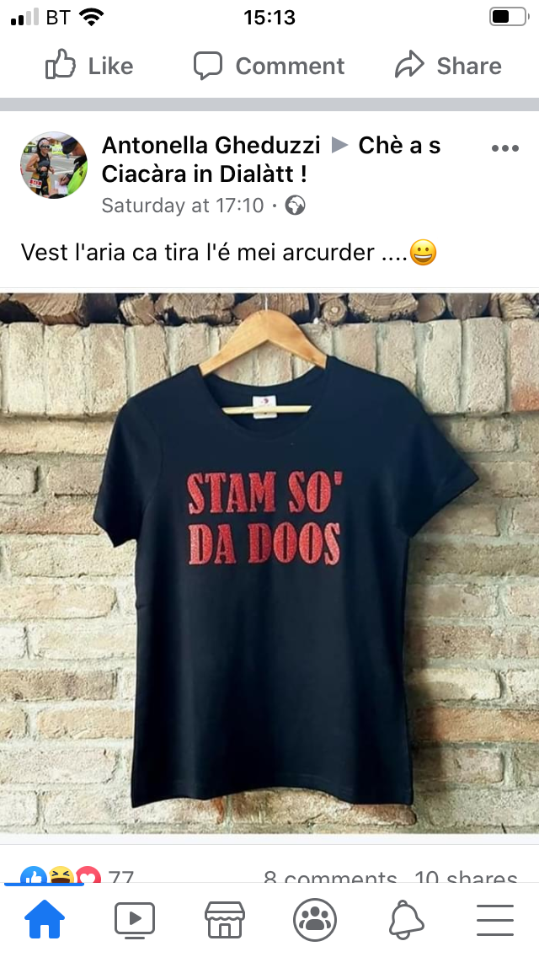
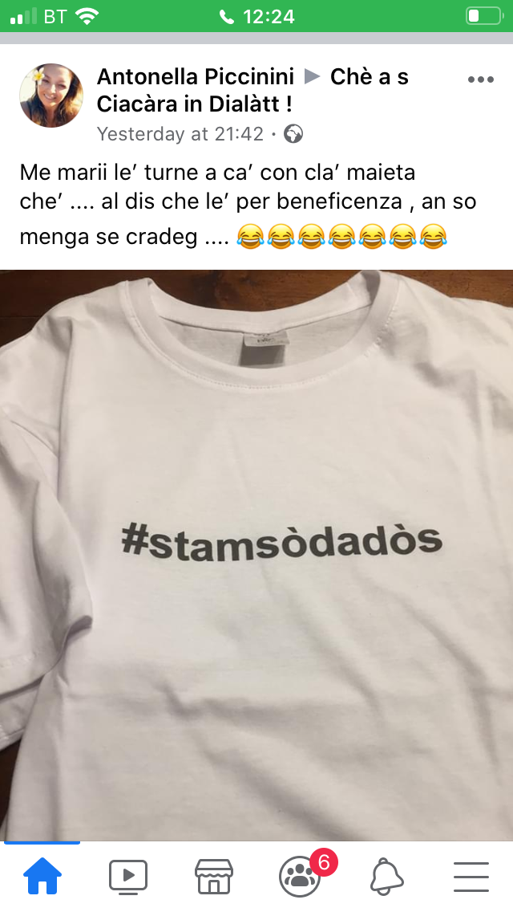
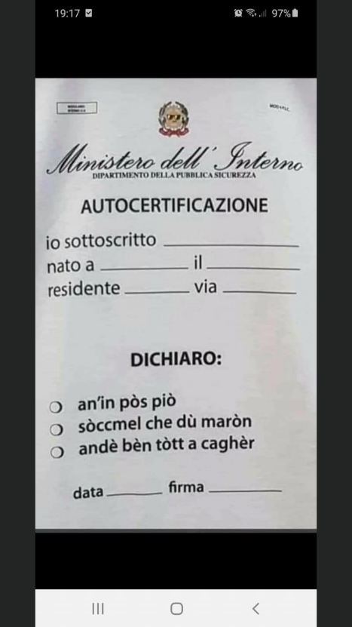
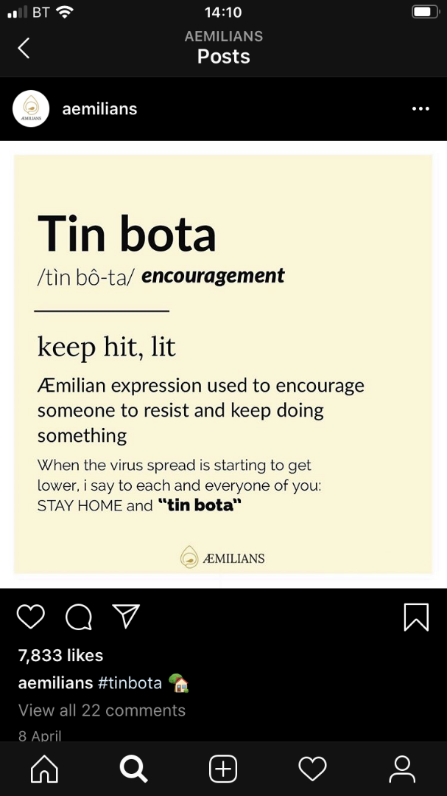

Slide 24
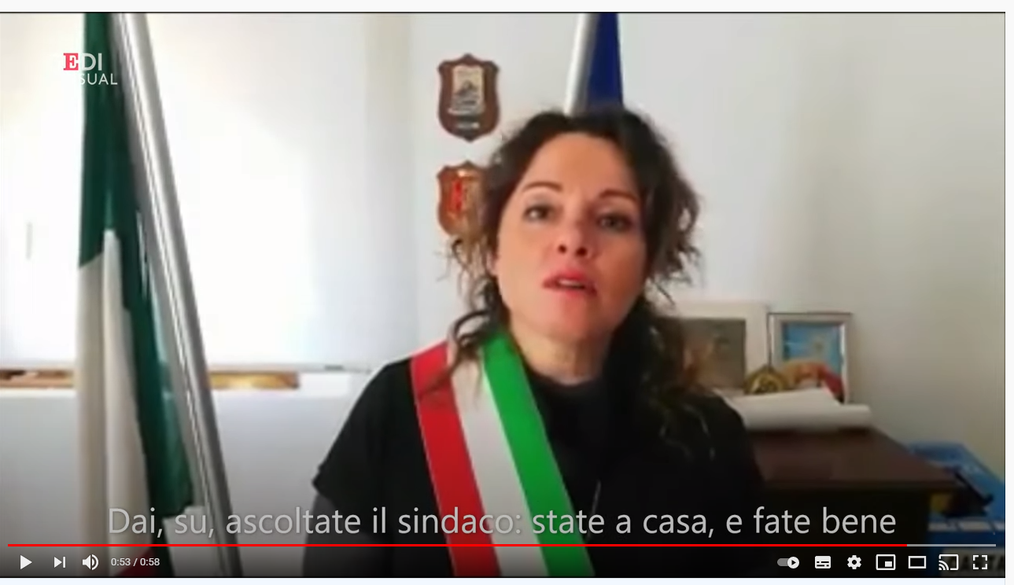
https://youtu.be/3BOGCP9mjv0

Slide 25
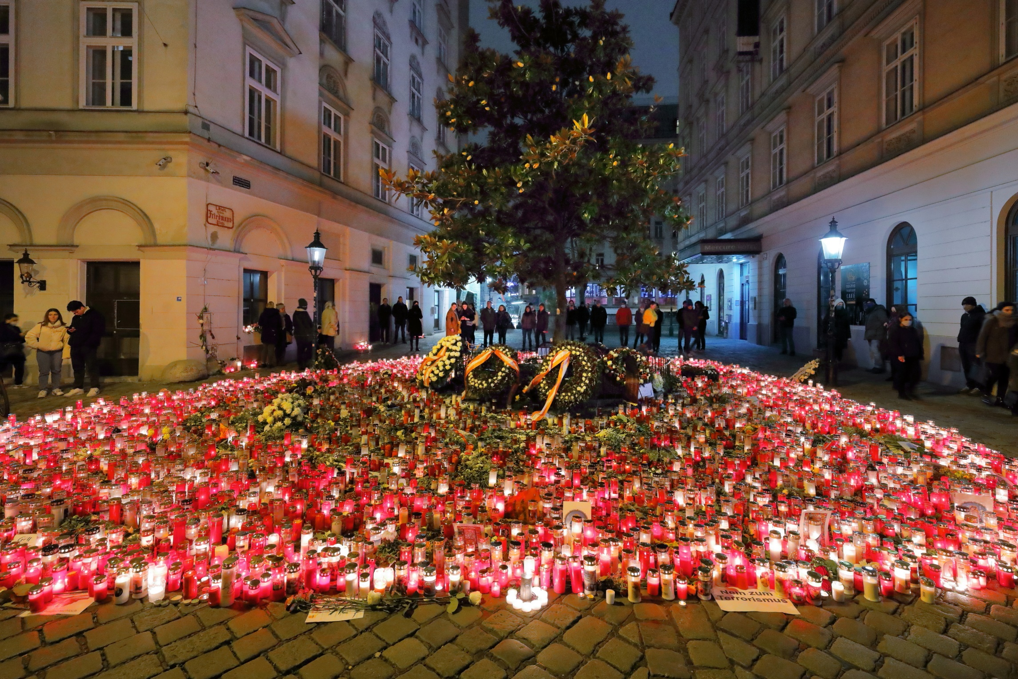
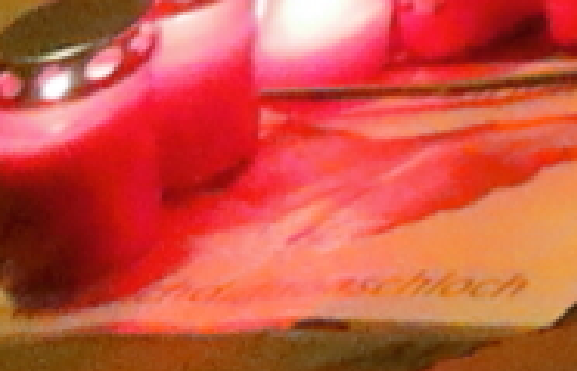
(Wikipedia - © Bwag/CC-BY-SA-4.0)

